Slide 1
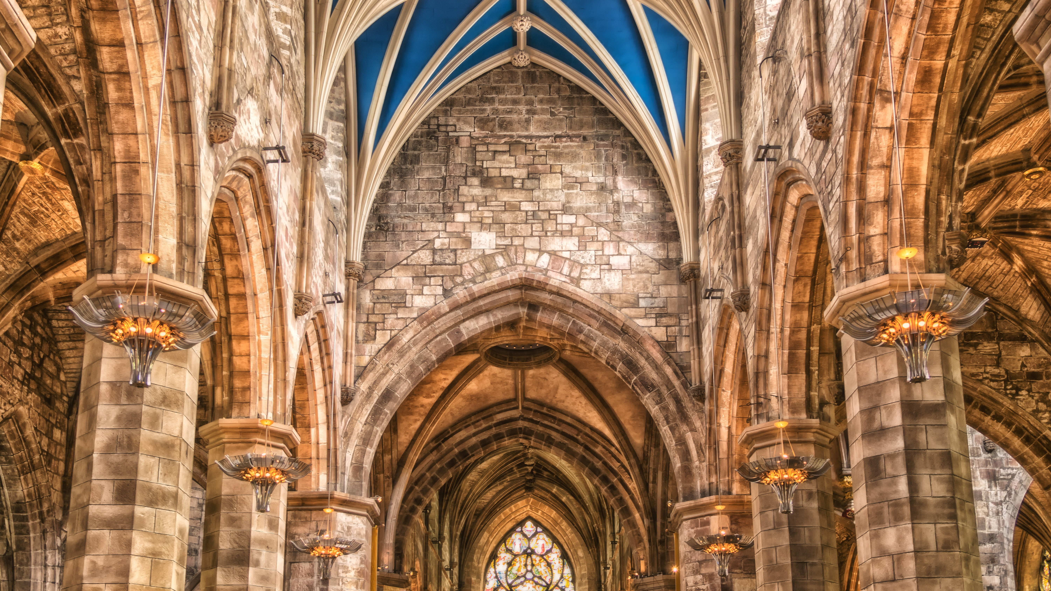
Session 6
Our Faith Community

Slide 2
A Covenant Prayer: For Creating Sanctuary Together
Gracious God Under the shadow of your wings We find welcome embrace and compassionate love, And in the coming of your son amongst us, We encounter the outstretched arms of Love without limits.
Help us to be your covenant people Reaching out to one another As Christ has reached out to us.

Slide 3
As we journey together Help us To be treated with care And met with love
To listen to the voices of those least heard And encourage all views to be respected To seek to be genuine and honest And not speak in ways that cause harm
To hold each other’s stories in confidence And exercise grace in our words and actions.
When disturbed or confused, To seek understanding

Slide 4
AMEN
When challenged or moved To embrace the learning
Help us on this journey to be strangers no longer, But pilgrims on the way For the sake of Jesus Who walks with us, breaks bread for us to share, and opens our eyes.

Slide 6
Small Group Questions
What characteristics and behaviours will we notice in our church community if we manage to live these values and principles together?
We won’t be perfect. We won’t always get it right. How do we commit to working together, and talking with each other, when things are difficult, or something goes wrong?
If we disagree with each other, how will we resolve those disagreements?
How can we best reach people outside of our church to communicate our values?

Slide 8
Jesus said: “It is finished” John 19:30 Jesus said: “Father, into thy hands I commit my spirit” Luke 23:46

Slide 9
Pause to Reflect
“I thank you God for fresh insight and understanding …”
“I ask you God for wisdom and discernment …”

Slide 10
Closing Song
Here in this place, new light is streaming, Now is the darkness vanished away. See, in this space, our fears and our dreamings, Brought here to you in the light of this day. Gather us in - the lost and forsaken, Gather us in - the blind and the lame. Call to us now, and we shall awaken, We shall arise at the sound of our name.

Slide 11
We are the young - our lives are a mystery, we are the old - who yearn for your face. We have been sung throughout all of history, Called to be light to the whole human race. Gather us in - the rich and the haughty, Gather us in - the proud and the strong. Give us a heart so meek and so lowly, Give us the courage to enter the song.

Slide 12
Here we will take the wine and the water, Here we will take the bread of new birth. Here you shall call your sons and your daughters, Call us anew to be salt for the earth. Give us to drink the wine of compassion, Give us to eat the bread that is you. Nourish us well, and teach us to fashion Lives that are holy and hearts that are true.

Slide 13
Not in the dark of buildings confining, Not in some heaven, light years away, But here in this place, the new light is shining; Now is the Kingdom, now is the day. Gather us in - and hold us forever, Gather us in - and make us your own. Gather us in - all peoples together, Fire of love in our flesh and our bone.

