Slide 1
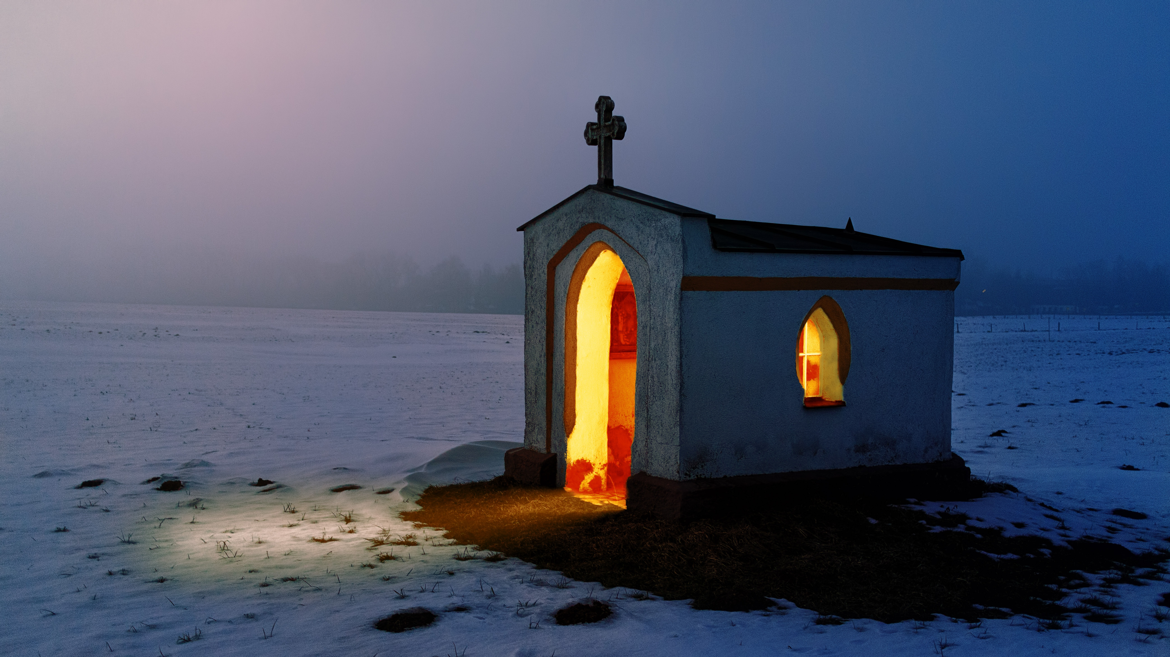
Session 5
Creating Safer Churches

Slide 2
A Covenant Prayer: For Creating Sanctuary Together
Gracious God Under the shadow of your wings We find welcome embrace and compassionate love, And in the coming of your son amongst us, We encounter the outstretched arms of Love without limits.
Help us to be your covenant people Reaching out to one another As Christ has reached out to us.

Slide 3
As we journey together Help us To be treated with care And met with love
To listen to the voices of those least heard And encourage all views to be respected To seek to be genuine and honest And not speak in ways that cause harm
To hold each other’s stories in confidence And exercise grace in our words and actions.
When disturbed or confused, To seek understanding

Slide 4
AMEN
When challenged or moved To embrace the learning
Help us on this journey to be strangers no longer, But pilgrims on the way For the sake of Jesus Who walks with us, breaks bread for us to share, and opens our eyes.

Slide 6
Hidden Cultures…
Are there people who sit in particular places in the church?
What is the church’s most popular biscuit?
Are there any phrases that are said most Sunday mornings?
What is the favourite event in the church calendar?

Slide 7
Notes:
The video will begin automatically. Before playing, please ensure you are connected to the internet.
The video is also available on our website: www.creatingsanctuary.org.uk/session-5

Slide 8
Characteristics of a healthy Christian Culture (Oakley & Humphreys, 2019)
Safeguarding as a foundation
Respects, values and nurtures
Guides and empowers through biblical teaching
Nurturing and nurtured leadership
Values ‘whole life’ services
Healthy accountability
Models inclusion
Guides behaviour but respects choices

Slide 9
Reflect on the following questions…
What does it feel like when we know we are safe, valued and respected?
How far do we reflect the hallmarks of a healthy culture in our church and in our community?
How does this kind of culture help to keep people safe, including those who identify as members of the LGBT+ community?
Are there areas in which we do not reflect these?

Slide 11
Jesus said: “My God My God why have you forsaken me” Matthew 27:46 & Mark 15:34

Slide 12
Prayer
Help us O God To build safer spaces In your church and in the community
Open our eyes to the needs of those who are vulnerable - the neglected - the bruised - the misjudged

Slide 13
Open our ears to the stories Less often heard about how people live And kindle in us through the story of salvation Such love grace and generosity of spirit As Christ has shown toward us. Let Christ’s cry from the cross not be in vain Let no-one, because of the church, feel abandoned or forsaken.
AMEN

Slide 14
Closing Song
Let us build a house where love can dwell and all can safely live, A place where saints and children tell how hearts learn to forgive. Built of hopes and dreams and visions, rock of faith and vault of grace; Here the love of Christ shall end divisions: All are welcome, all are welcome, All are welcome in this place. All are welcome, all are welcome, All are welcome in this place.

Slide 15
Let us build a house where prophets speak, and words are strong and true, Where all God’s children dare to seek To dream God’s reign anew. Here the cross shall stand as witness and as symbol of God’s grace; Here as one we claim the faith of Jesus: All are welcome, all are welcome, All are welcome in this place

Slide 16
Let us build a house where love is found in water, wine and wheat: A banquet hall on holy ground where peace and justice meet. Here the love of God, through Jesus, is revealed in time and space; As we share in Christ the feast that frees us. All are welcome, all are welcome, All are welcome in this place.

Slide 17
