Slide 1
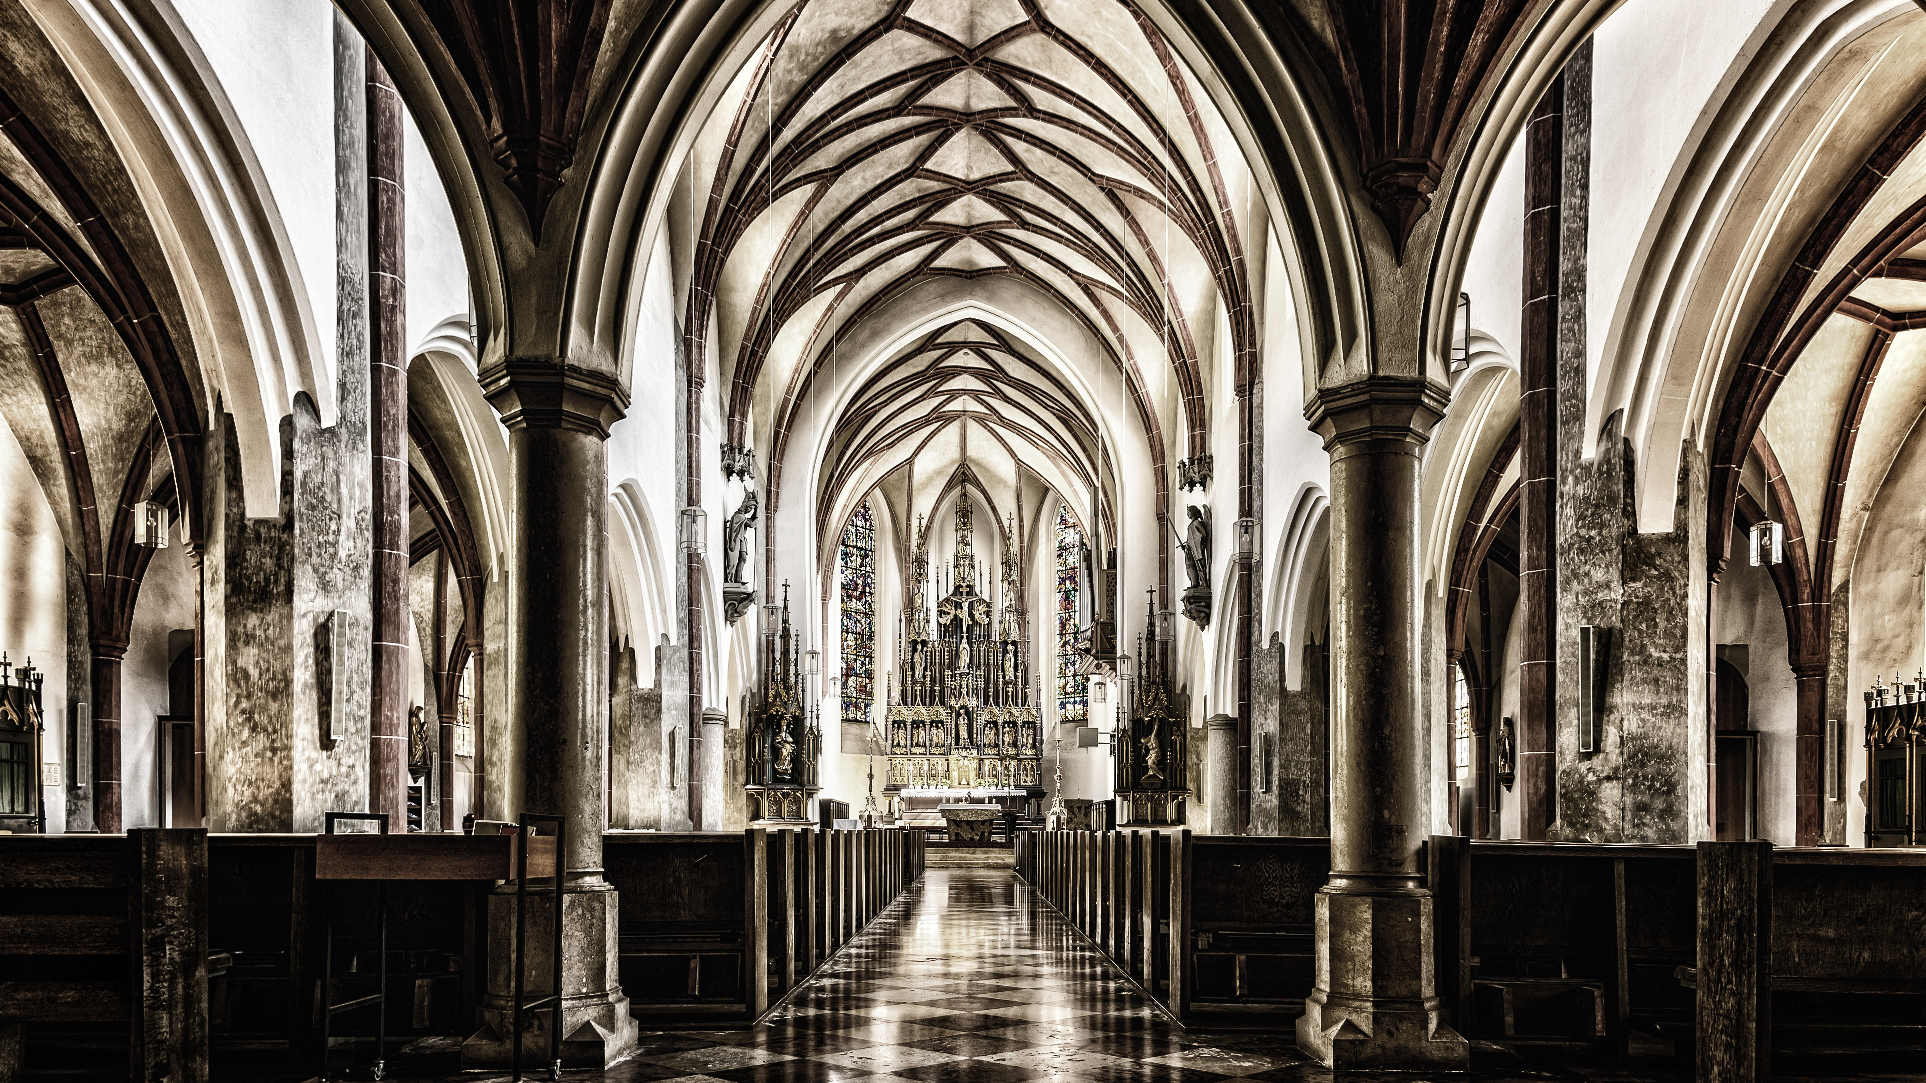
Session 2
Listening Deeply to Stories

Slide 2
A Covenant Prayer: For Creating Sanctuary Together
Gracious God Under the shadow of your wings We find welcome embrace and compassionate love, And in the coming of your son amongst us, We encounter the outstretched arms of Love without limits.
Help us to be your covenant people Reaching out to one another As Christ has reached out to us.

Slide 3
As we journey together Help us To be treated with care And met with love
To listen to the voices of those least heard And encourage all views to be respected To seek to be genuine and honest And not speak in ways that cause harm
To hold each other’s stories in confidence And exercise grace in our words and actions.
When disturbed or confused, To seek understanding

Slide 4
AMEN
When challenged or moved To embrace the learning
Help us on this journey to be strangers no longer, But pilgrims on the way For the sake of Jesus Who walks with us, breaks bread for us to share, and opens our eyes.

Slide 6
Story 1
Notes:
Audio will start automatically.
If you are struggling to hear the story, please check that the volume is turned up on your computer and sound equipment.
The stories are also available from our website: www.creatingsanctuary.org.uk/session-2

Slide 7
Small group questions
What thoughts do you have about this story?
What impact has the story had on you?
What feelings do you have?
What questions are you left with?

Slide 8
Story 2
Notes:
Audio will start automatically.
If you are struggling to hear the story, please check that the volume is turned up on your computer and sound equipment.
The stories are also available from our website: www.creatingsanctuary.org.uk/session-2

Slide 9
Small group questions
What thoughts do you have about this story?
What impact has the story had on you?
What feelings do you have?
What questions are you left with?

Slide 10
Story 3
Notes:
Audio will start automatically.
If you are struggling to hear the story, please check that the volume is turned up on your computer and sound equipment.
The stories are also available from our website: www.creatingsanctuary.org.uk/session-2

Slide 11
Small group questions
What thoughts do you have about this story?
What impact has the story had on you?
What feelings do you have?
What questions are you left with?

Slide 12
Story 4
Notes:
Audio will start automatically.
If you are struggling to hear the story, please check that the volume is turned up on your computer and sound equipment.
The stories are also available from our website: www.creatingsanctuary.org.uk/session-2

Slide 13
Small group questions
What thoughts do you have about this story?
What impact has the story had on you?
What feelings do you have?
What questions are you left with?

Slide 14
Story 5
Notes:
Please note - there are no audio files attached to this PPT.
The stories are available from our website: www.creatingsanctuary.org.uk/session-2
There is also a larger version of this PPT with the stories embedded,

Slide 15
Small group questions
What thoughts do you have about this story?
What impact has the story had on you?
What feelings do you have?
What questions are you left with?

Slide 16
What could we do to make our church(es) a safer place for each of the people whose stories we have heard.

Slide 17
Notes:
The video will begin automatically. Before playing, please ensure you are connected to the internet.
The video is also available on our website: www.creatingsanctuary.org.uk/session-2

Slide 18
Consider these questions posed by Nick Bundock, Lizzie’s Vicar:
Which part of this story is the most important part to you?
Which part of this story is most relevant to your church?
Might this story have ended differently had Lizzie been a member of your church?

Slide 20
“Today you will be with me in paradise.” Luke 23:43

Slide 21
Pause to Reflect
What does it mean today, for the harmed and the hurting to hear these words,
“Today you shall be with me in paradise.”?

Slide 22
Paradise Now
In the pain of rejection Under the scrutiny of a graceless world In the night-time of my fear
Jesus’ words are balm to my brokenness

Slide 23
When doubt and disappointment overshadow me fear and uncertainly consume me and friends no longer hear me
Jesus’ words calm my restlessness
When who I am is not understood or what I feel is not acknowledged When the body I inhabit is not loved

Slide 24
Jesus’ words restore my humanity
Wherever the body of Christ Binds the wounds of the broken Comforts the restless Rescues and restores the rejected
Jesus’ promise comes alive - Paradise Now

Slide 25
Prayer
Gracious God, We have listened to the stories, We have heard the pain caused by silence and indifference.
Help us to find the boldness to break our silences, To speak truth to power, To make the space so that voices within our community are heard, So we too can better reflect your love and welcome to all

Slide 26
AMEN
On the cross , Even through your pain and discomfort, You reached out to offer hope and life to others.
Give us courage and grace to exchange out judgements and prejudices, For your gracious love and compassion.

Slide 27
Closing Song
Here in this place, new light is streaming, Now is the darkness vanished away. See, in this space, our fears and our dreamings, Brought here to you in the light of this day. Gather us in - the lost and forsaken, Gather us in - the blind and the lame. Call to us now, and we shall awaken, We shall arise at the sound of our name.

Slide 28
We are the young - our lives are a mystery, we are the old - who yearn for your face. We have been sung throughout all of history, Called to be light to the whole human race. Gather us in - the rich and the haughty, Gather us in - the proud and the strong. Give us a heart so meek and so lowly, Give us the courage to enter the song.

Slide 29
Here we will take the wine and the water, Here we will take the bread of new birth. Here you shall call your sons and your daughters, Call us anew to be salt for the earth. Give us to drink the wine of compassion, Give us to eat the bread that is you. Nourish us well, and teach us to fashion Lives that are holy and hearts that are true.

Slide 30
Not in the dark of buildings confining, Not in some heaven, light years away, But here in this place, the new light is shining; Now is the Kingdom, now is the day. Gather us in - and hold us forever, Gather us in - and make us your own. Gather us in - all peoples together, Fire of love in our flesh and our bone.

